Slide 1
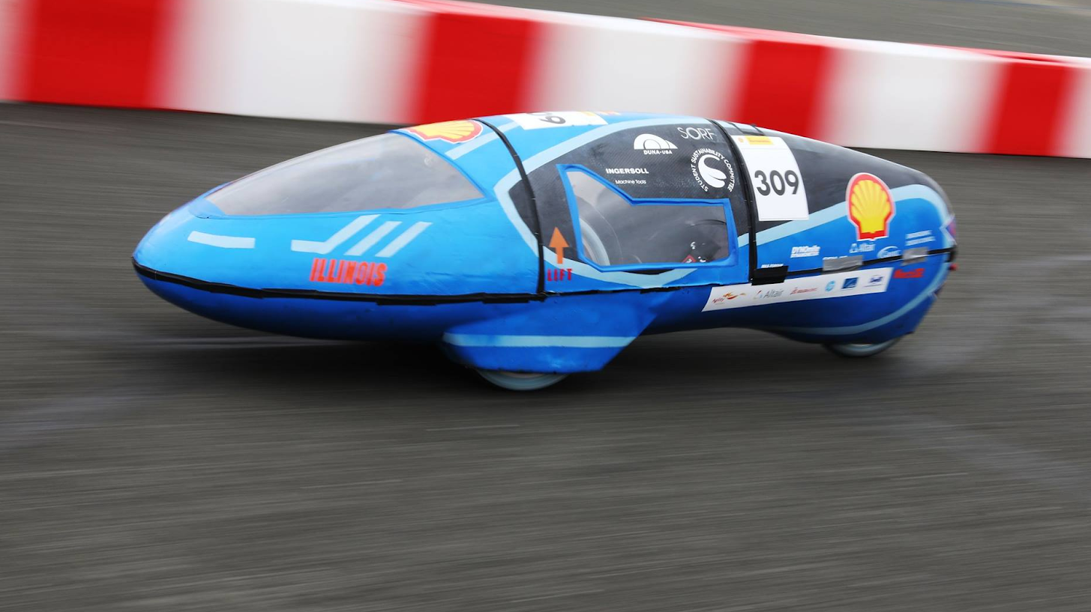

Eco Illini Supermileage
Week:
4/6/2020

Slide 2
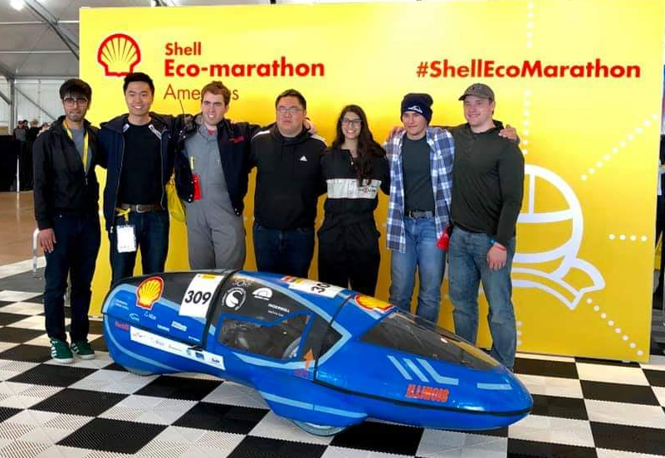
Timeline
Goals for the week:
Calls with leadership candidates
Talk with confirmed leads on content
Fall 2020 Timeline
Other Goals:
Have full assemblies with electronics by end of semester
Wiki: Project pages for new members, process diagrams for leads
Quad Day materials and posters: get ready now

Slide 3
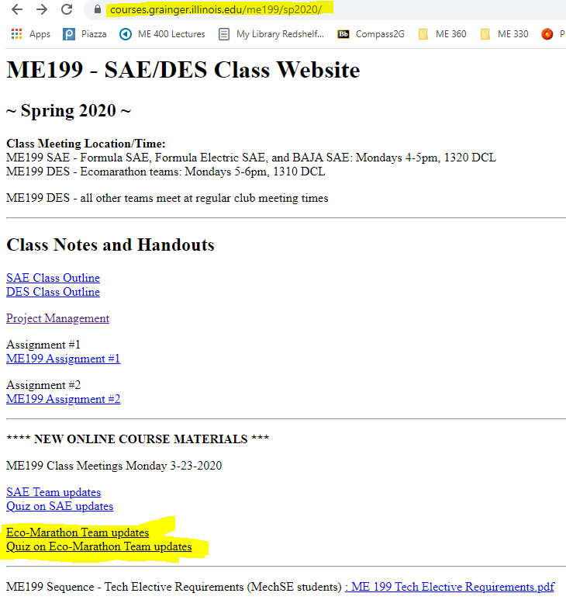
ME 199 and Class Participation
In-class participation suspended
Meetings temporarily on hold
Course Evaluation: (How we will evaluate/give you a grade)
Participation on projects/planning through the rest of SP 2020
Completed CAD Assemblies of projects
Email skamzol2@Illinois.edu for Solidworks
If unable to run, see below
Team Wiki:
Post project work, information/research, methods towards completing your project, and status of project → Why did you do what you did???
List where future development could be made (if any)
Paper: Write conclusion of where project is left at, steps needed to finish it, and rough time needed to assemble/test
Attendance: Take “Quiz”; based on these PPT’s!

Slide 4

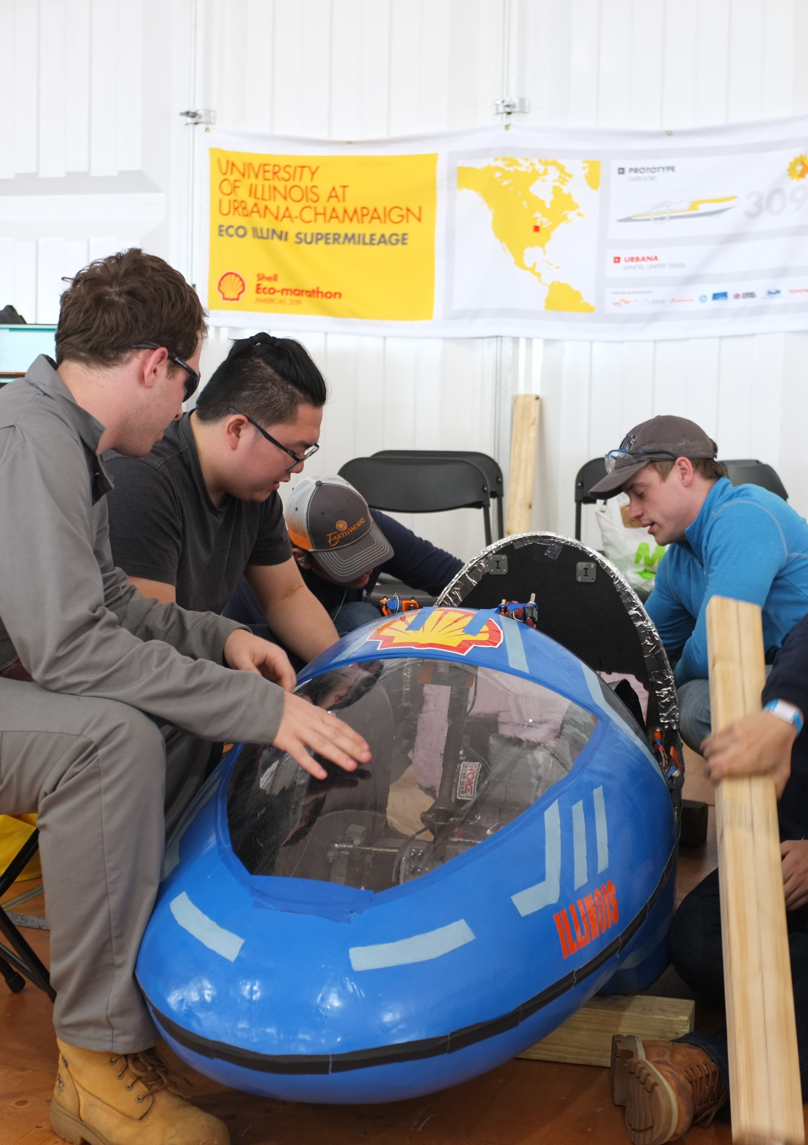
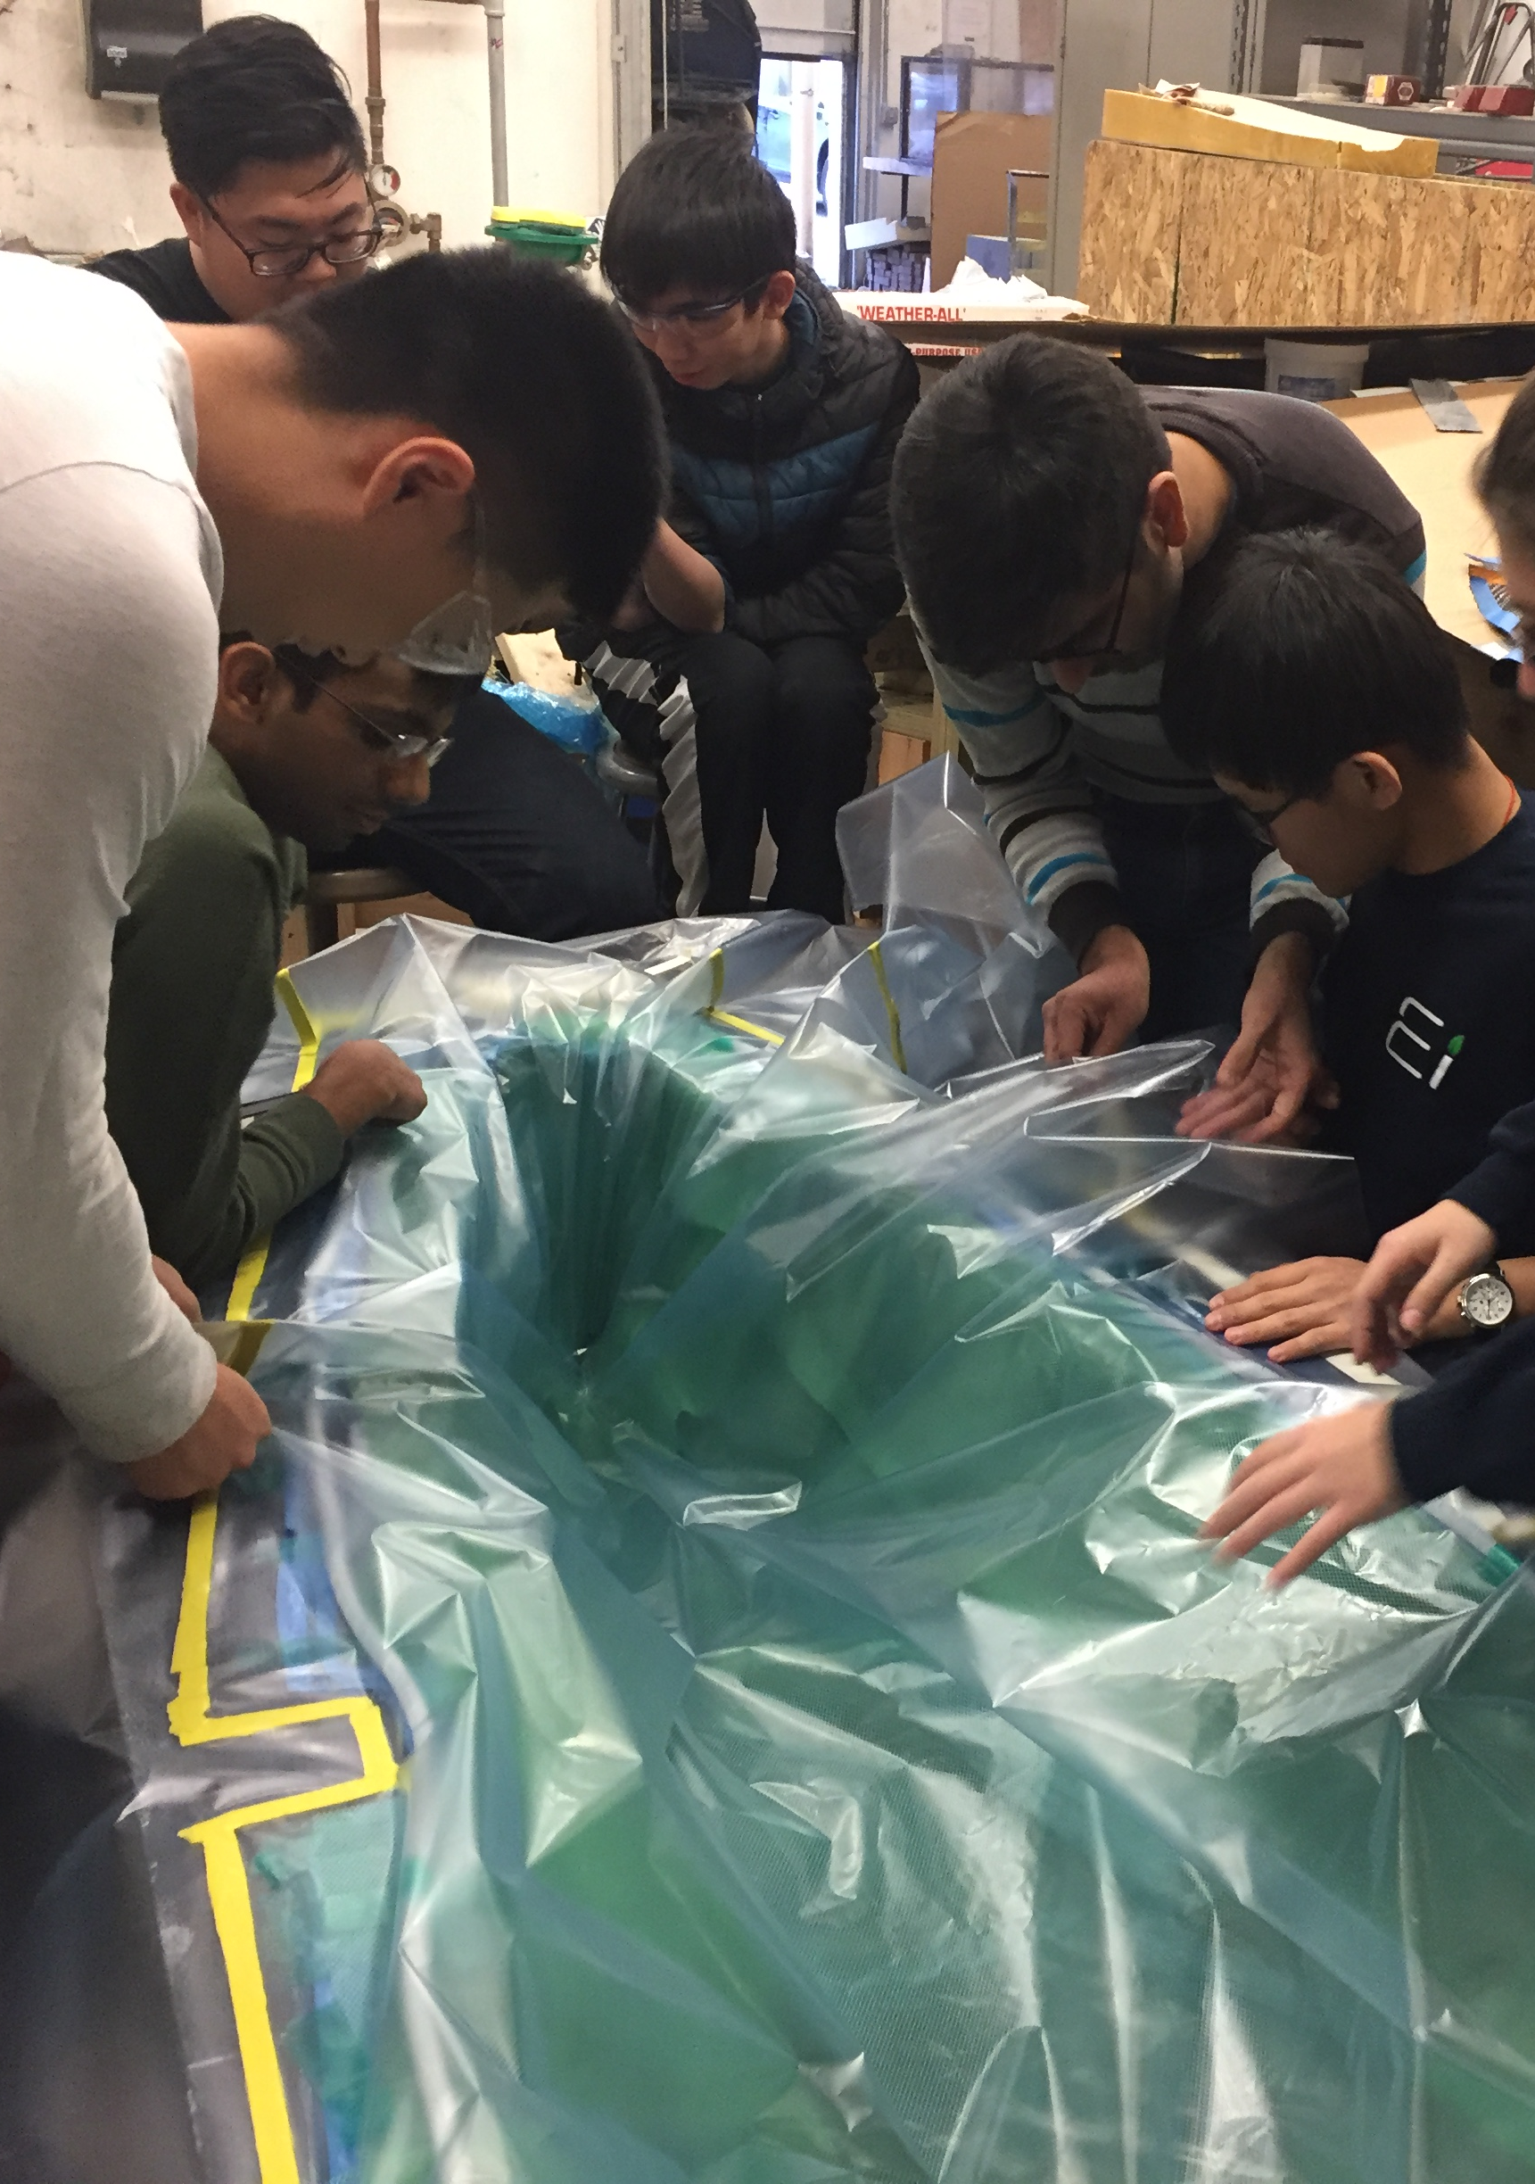
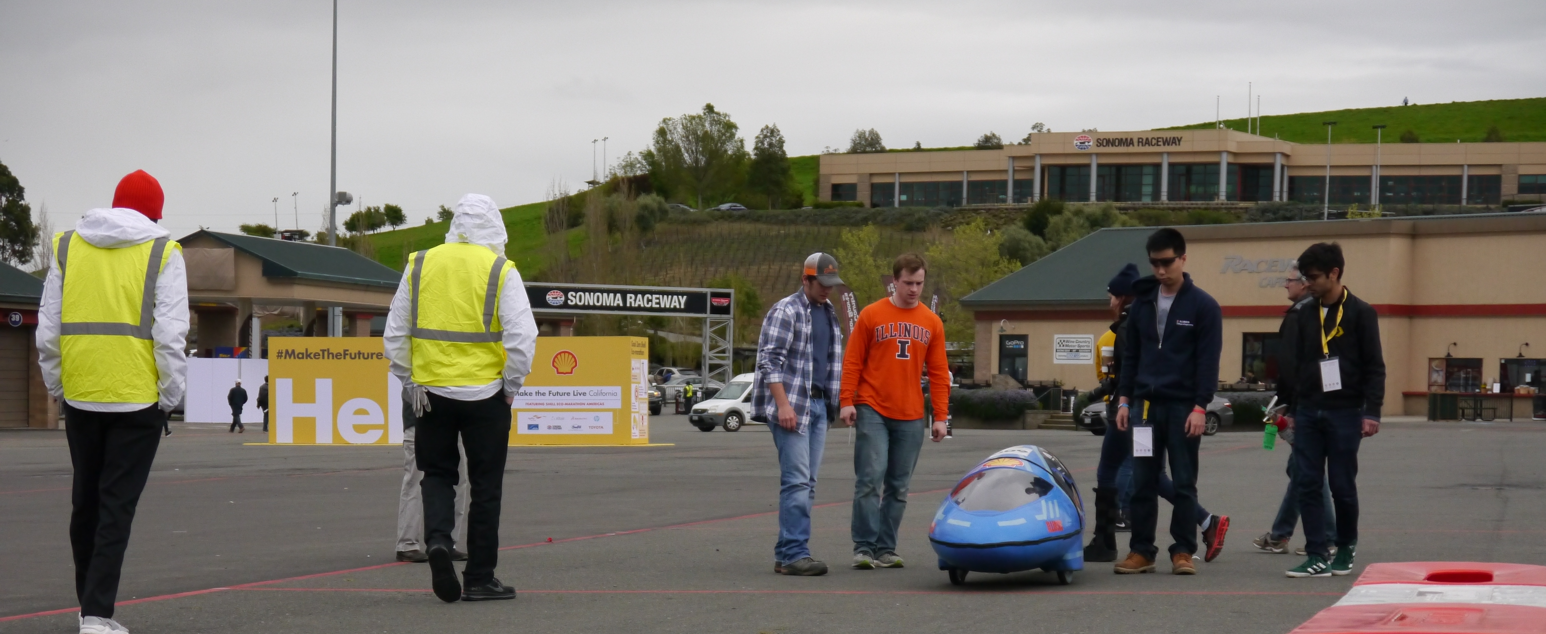
Mechanical

Slide 5
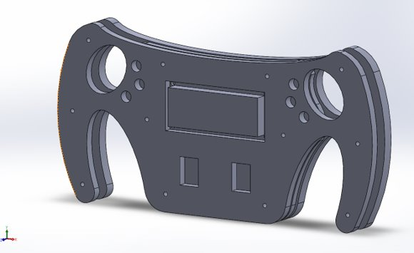
Mechanical
Working on assemblies
Design new gear for electrics drivetrain
Mechanical Subteam arrangement for next year
Goal: Place specialists in charge of different critical subgroups
Workflow plans managed between subsystem and specialist leads
Keep members engaged and provide central contact/chain for development
Structure for 2020-2021
Mechanical Lead
Engine Lead
Brakes/Steering Lead
Testing Lead

Slide 6
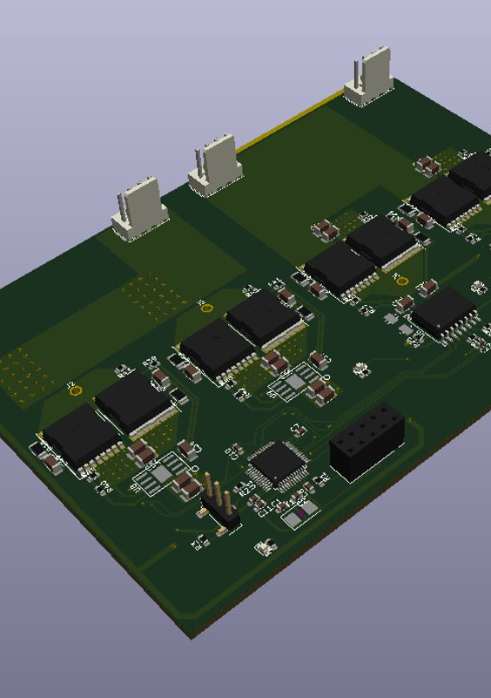
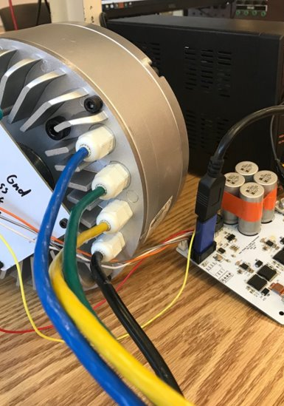
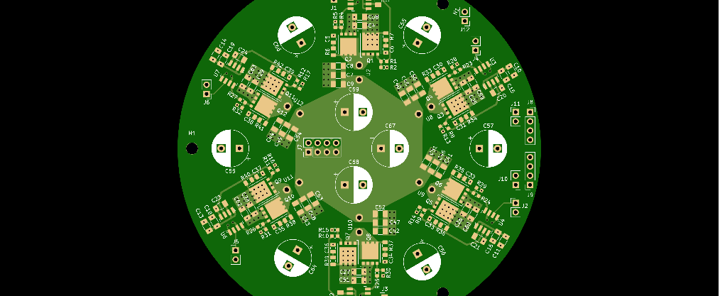
Electrical

Slide 7
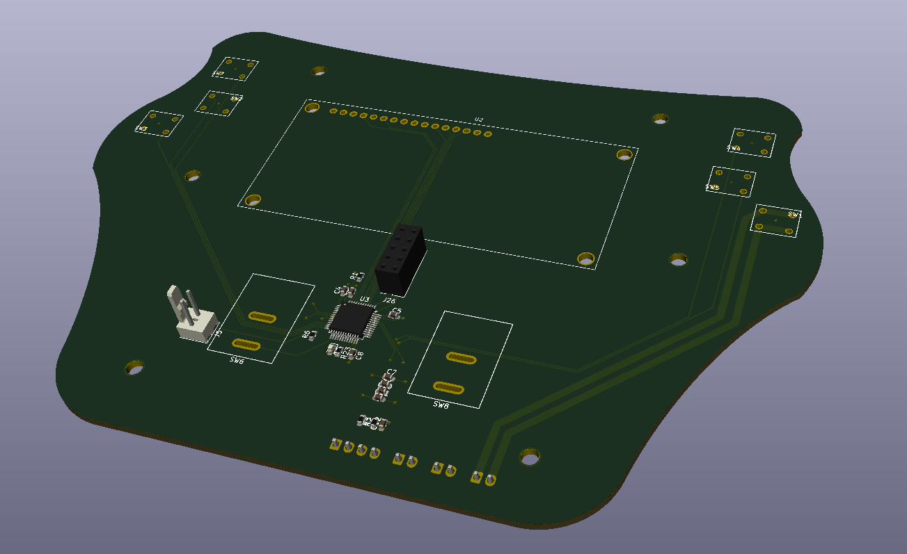
Electrical
Shifting gears from electrical to gas for SAE
Battery manufactured
Steering wheel pcb design
Working on motor mounting issues
Moving back to shelved projects
Alex moves to joint-Eco lead developer
New Electrics subteam lead

Slide 8
Body

Slide 9
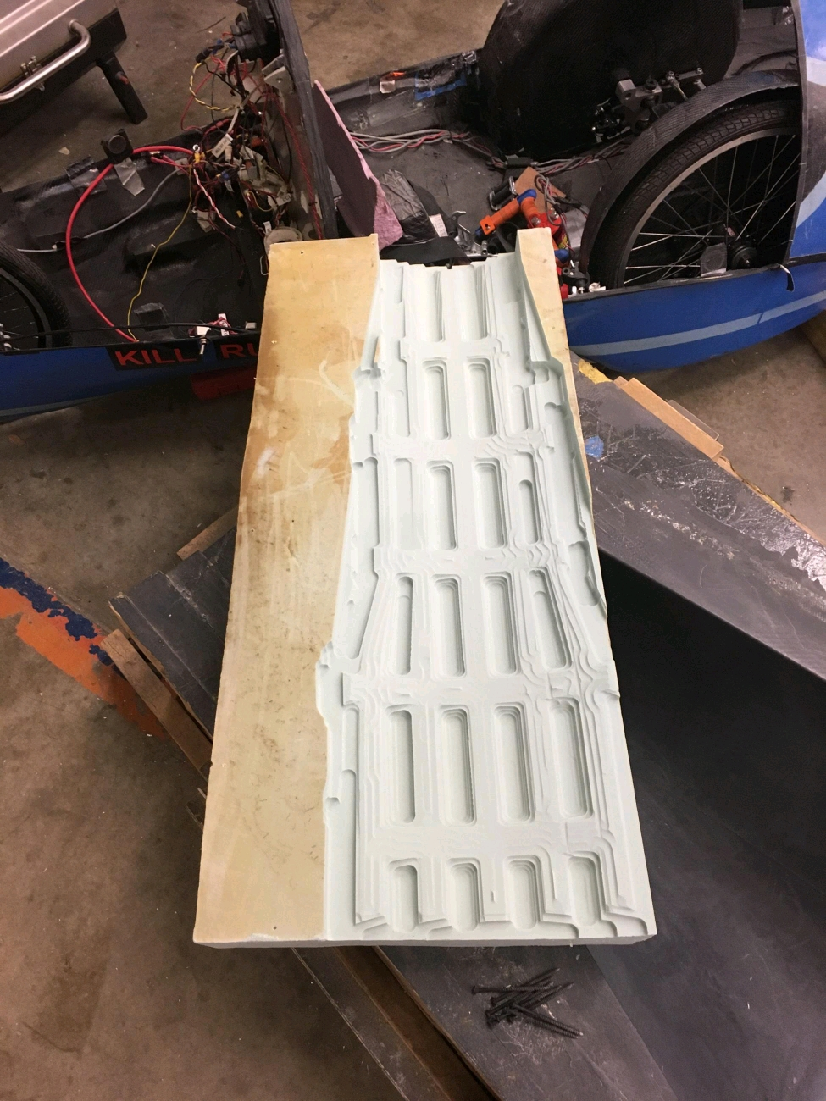
Body Projects
Front truss layup done
Aircore ready for VARTM
1-1.5 weeks away from rolling car pending ESPL opening
Leadership maintains current structure

Slide 10
Aero

Slide 11
Aero Projects
Get Ansys license
Working on Ansys simulations from home, results will be shared!

Slide 12
Manufacturing

Slide 13
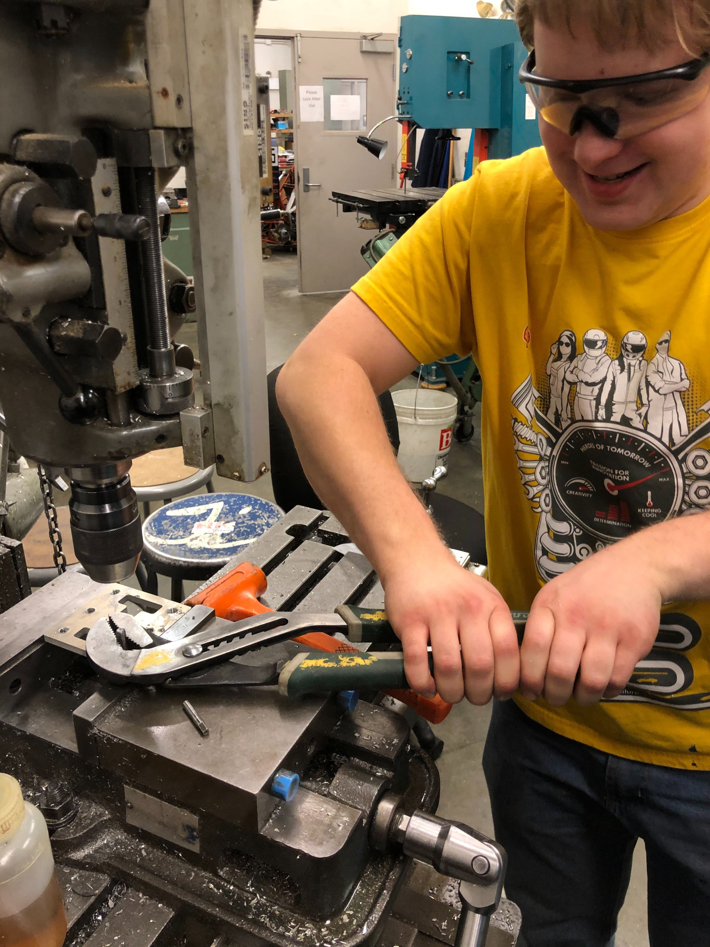
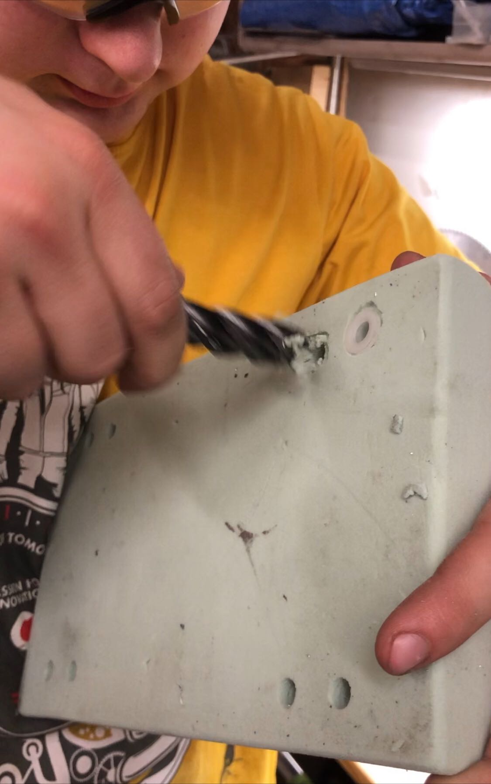
Progress
Waterjet – 98% (need new gear)
Machining: ~85% complete
Welding: ~50% complete
Highlights
Rolling car ready

Slide 14
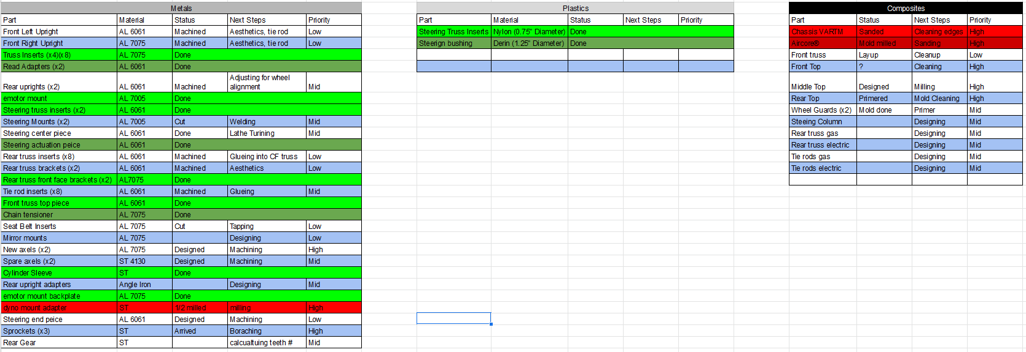
Manufacturing

Slide 15


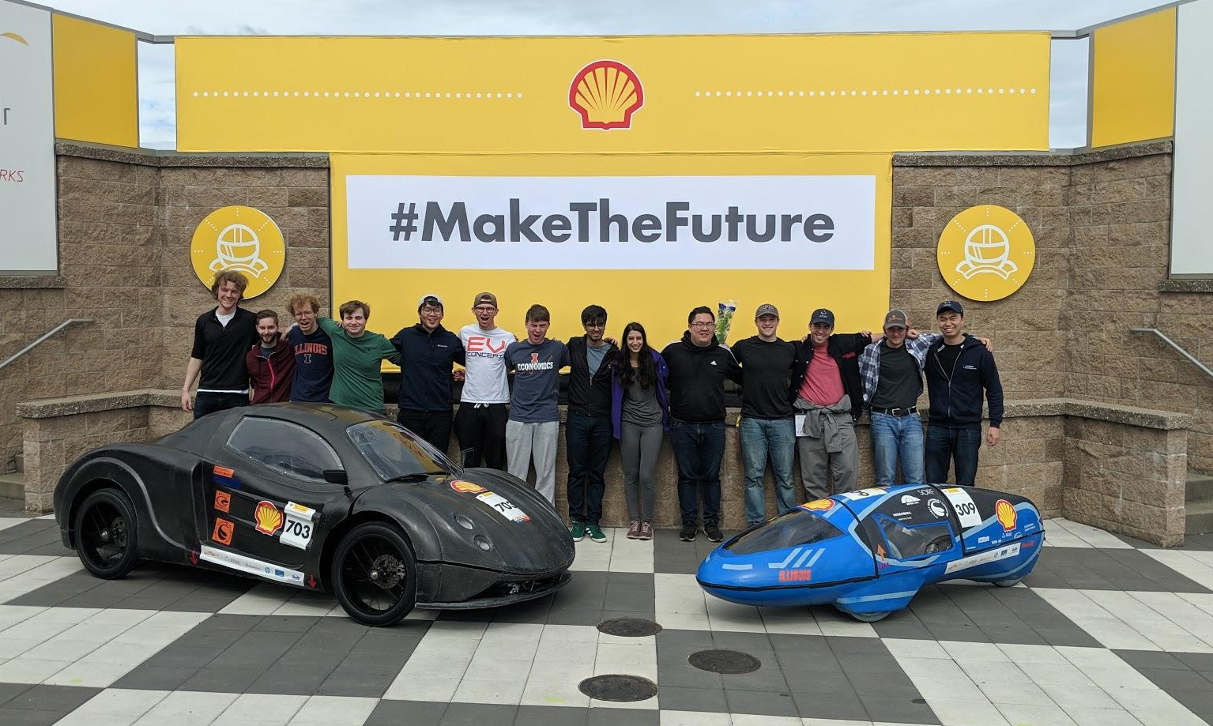


Slide 16
Mechanical Team - Robert Mauge
Researching ways to further improve mechanical systems
Accelerometer and strain gauge to determine stresses on chassis and suspension
DFA for entire car suspension and chassis

Slide 17
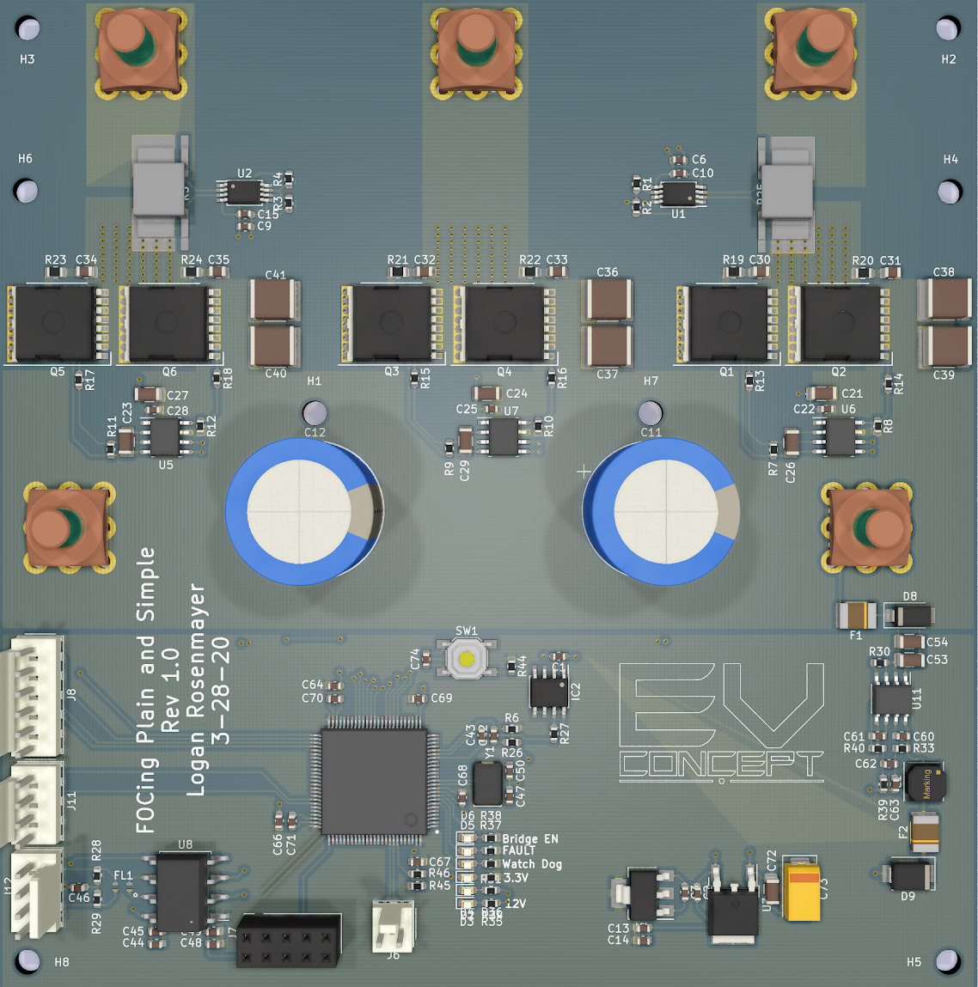
Electronics Team - Moving the Car
Redesigning the motor controller- Reduced cost by $40
Continuing redesign
Using STM32’s built in ADCs
H7 series has built in oversampling
Replaces most expensive part
Removed overkill linreg
Replacement is cheaper and easier to solder
Electronics meetings will be crash courses on critical topics for the team not taught in class
Zoom meetings that are recorded (Logan Lectures)
Format: Premade slide decks
Covers concepts and math used in designing
Topics: Motor control, Li-Ion batteries, STM32 coding (2 lectures each)
Lectures recorded and uploaded to our Google Drive

Slide 18
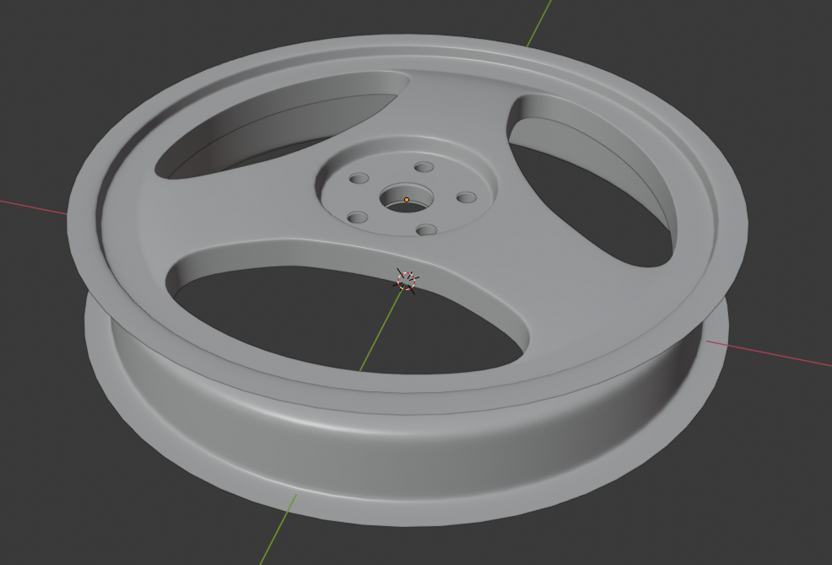
Composites Team - Richard Mauge
Switched from 8 spoke to 3 spoke
Significantly easier to manufacture and prepare
Need to reanalyze the rim to confirm which carbon fiber layout to use
Layup from 0 45 -45 0 vs. 0 60 - 60
Need to confirm if fibers running parallel with the spokes will reduce its strength
Documentation coming along well
Chemicals
Carbon fiber layups
Mold manufacturing

Slide 19
Financials - Richard Mauge
Discovered many accounting discrepancies between our accounting and MEB financial office’s accounting
Already discovered $3,000 charge from VR3 Engineering for tube bending (business office charged other teams expense to our account)
Shell Eco-Marathon travel stipend still not added ($2,000)
Full scale investigation into the last 4 years of money spent and received in conjunction with MEB financial office

